Slide 1
Incredible Edibles Harvesting and Enjoying
Log of Evidence
Burgess N.S.
1ST 2ND 3RD Class

Slide 2
The Fruits of our labours!
We checked on our produce every day
We watered the plants
We started harvesting on May 25th
We enjoyed recipes with our produce

Slide 3
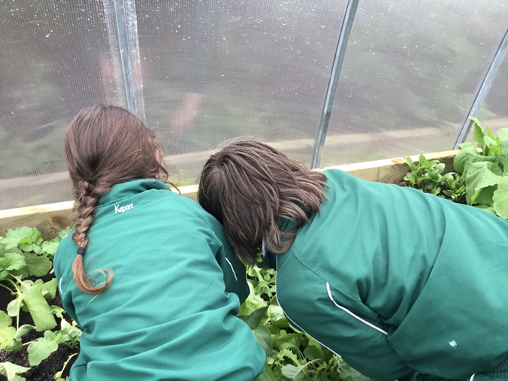
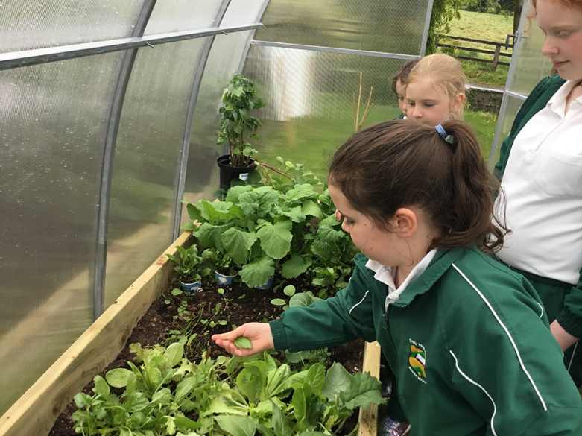
Harvest Time in Burgess!

Slide 4
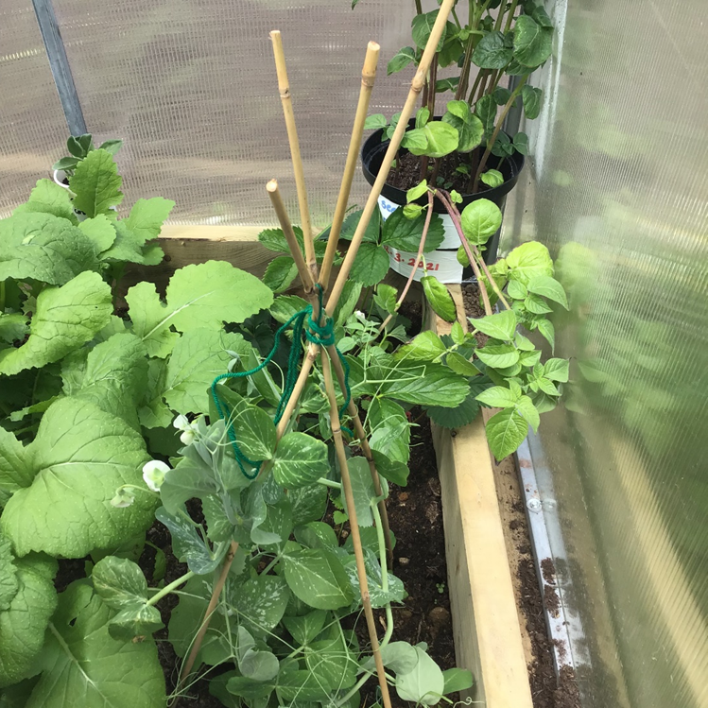
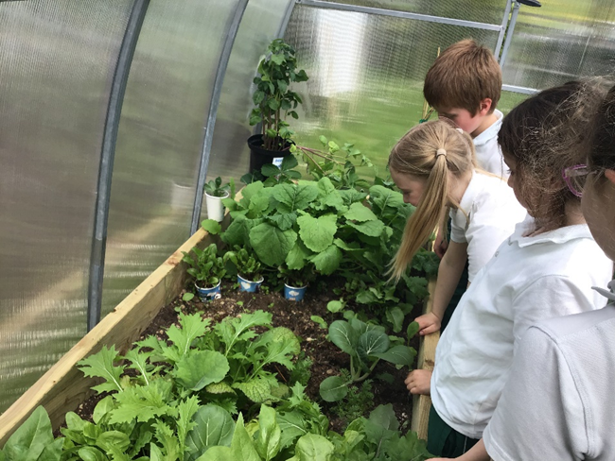

Slide 5
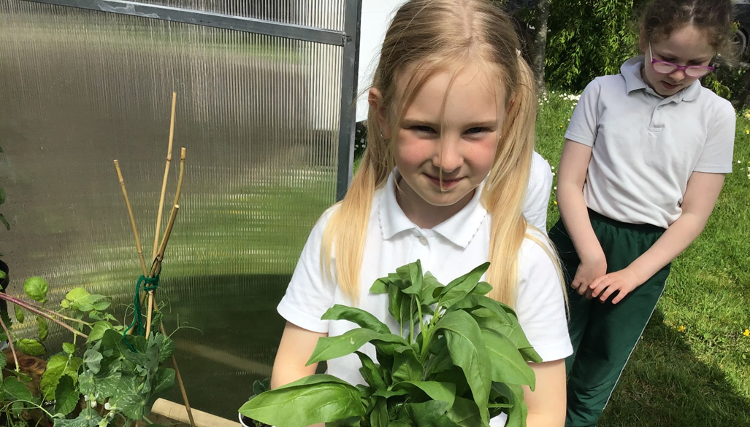
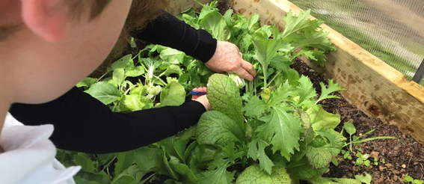
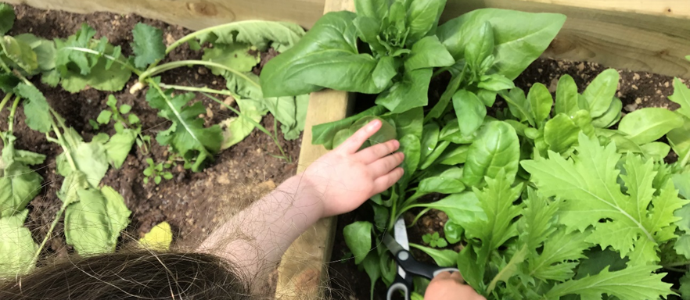
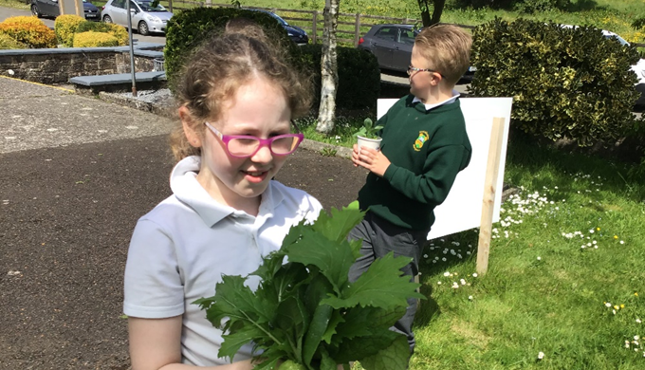
Spinach and Salad were our first vegetables

Slide 6
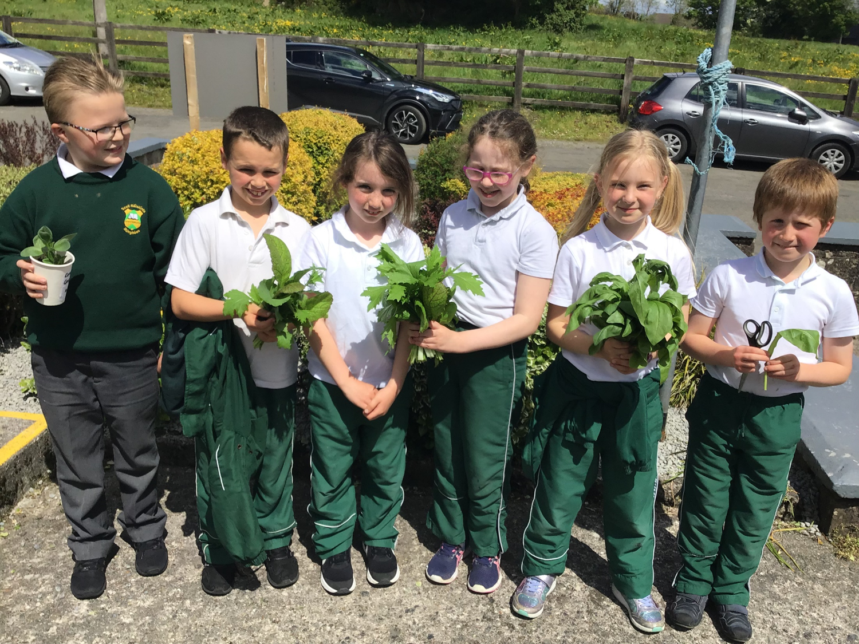

Slide 7
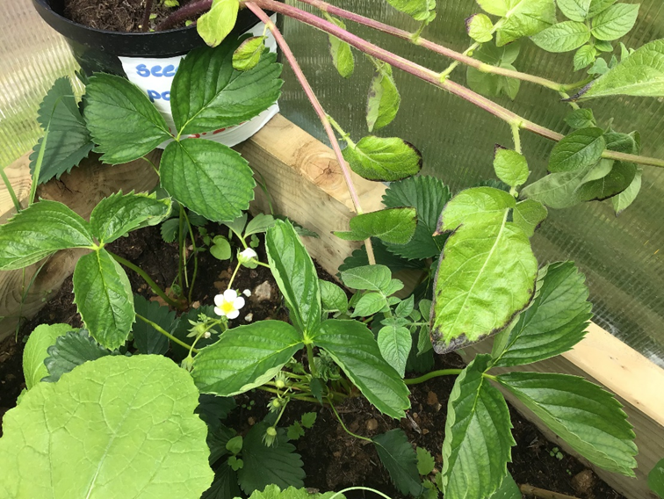
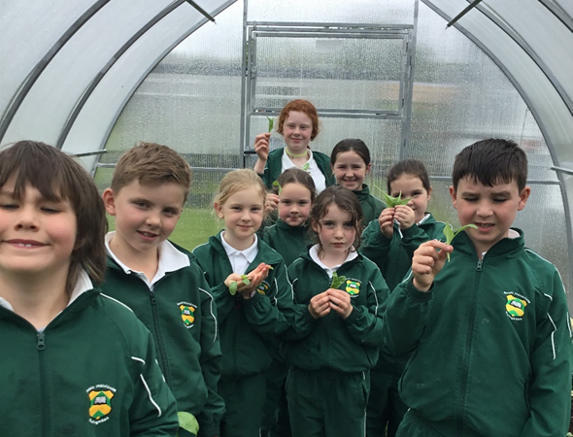
Strawberry plans doing well

Slide 8
Two great growers!

Slide 9
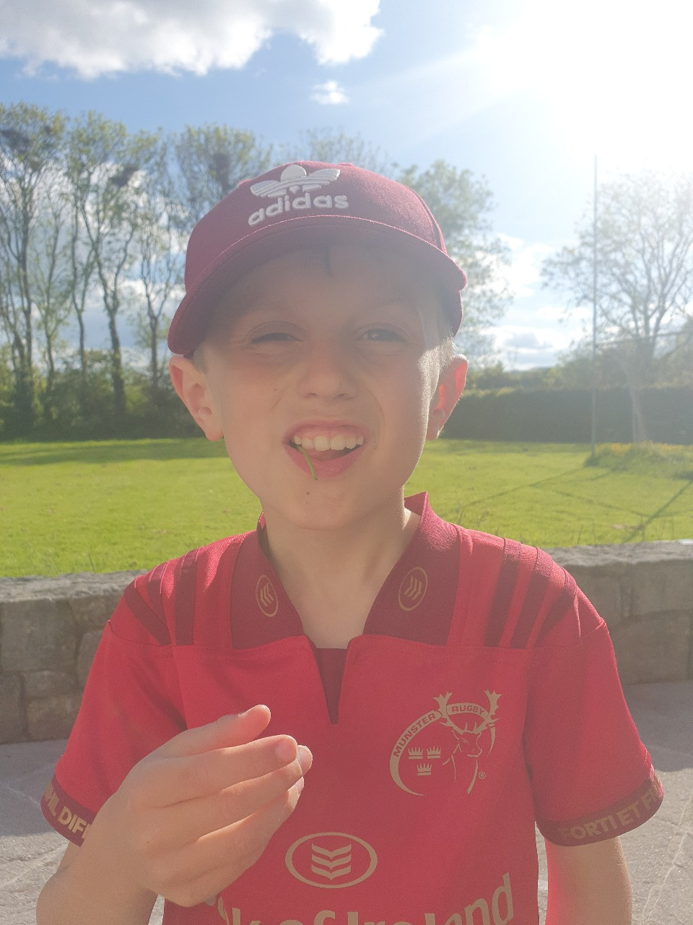
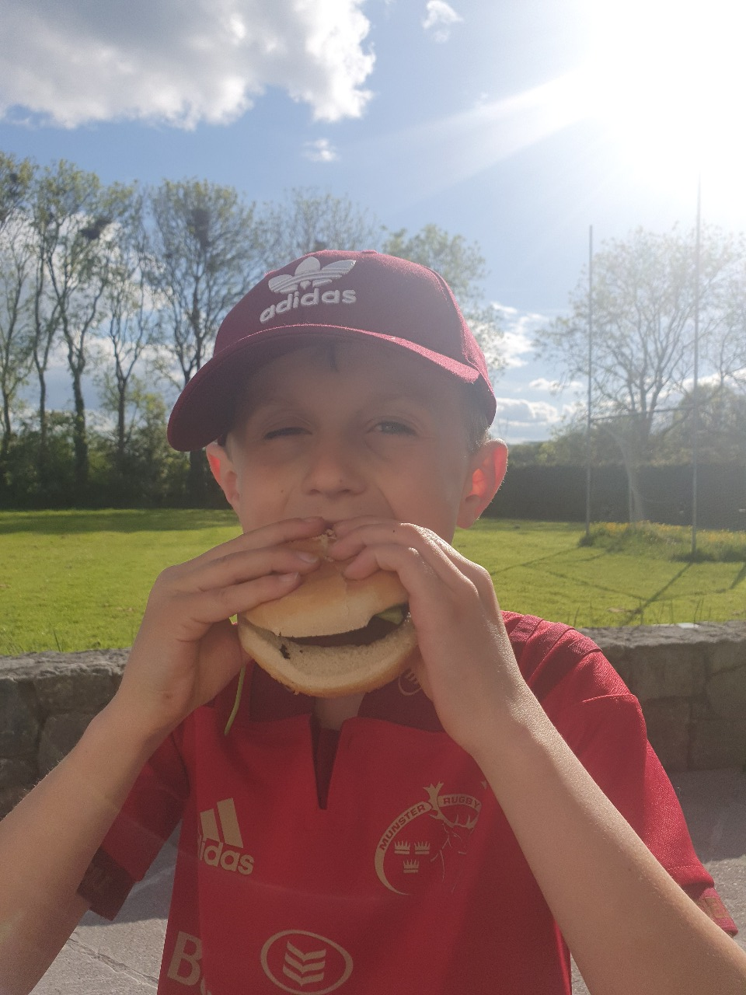
Trying out Burgess organic vegetables!

Slide 10
Adam made this delicious healthy salad for tea.

Slide 11
Olivia is continuing the Incredibles journey at home…. Check out her video

Slide 12
Olivia mixed the spinach she grew in school with some fruit, milk and honey from her Grandad’s bee hive to make this smoothie.

Slide 13
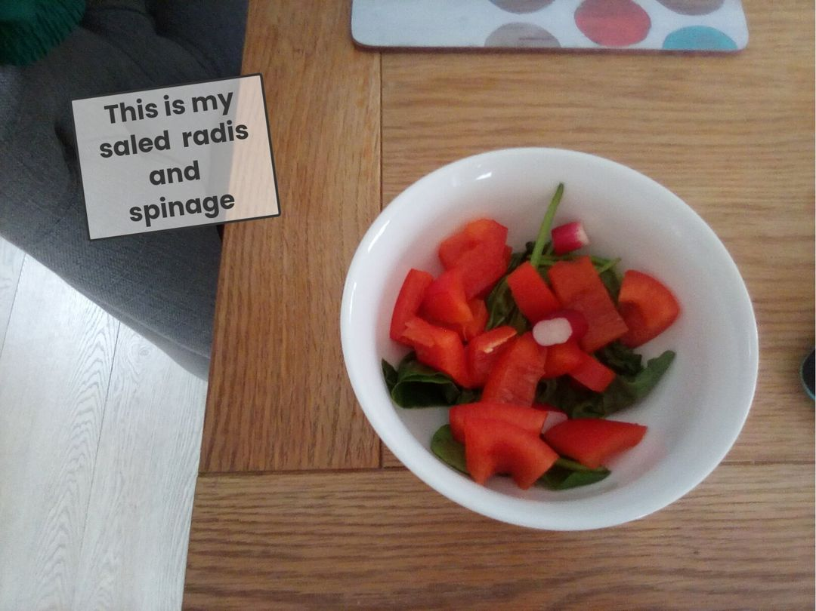

Slide 14
Smoothie Friday!

Slide 15
Smoothie Friday

Slide 16
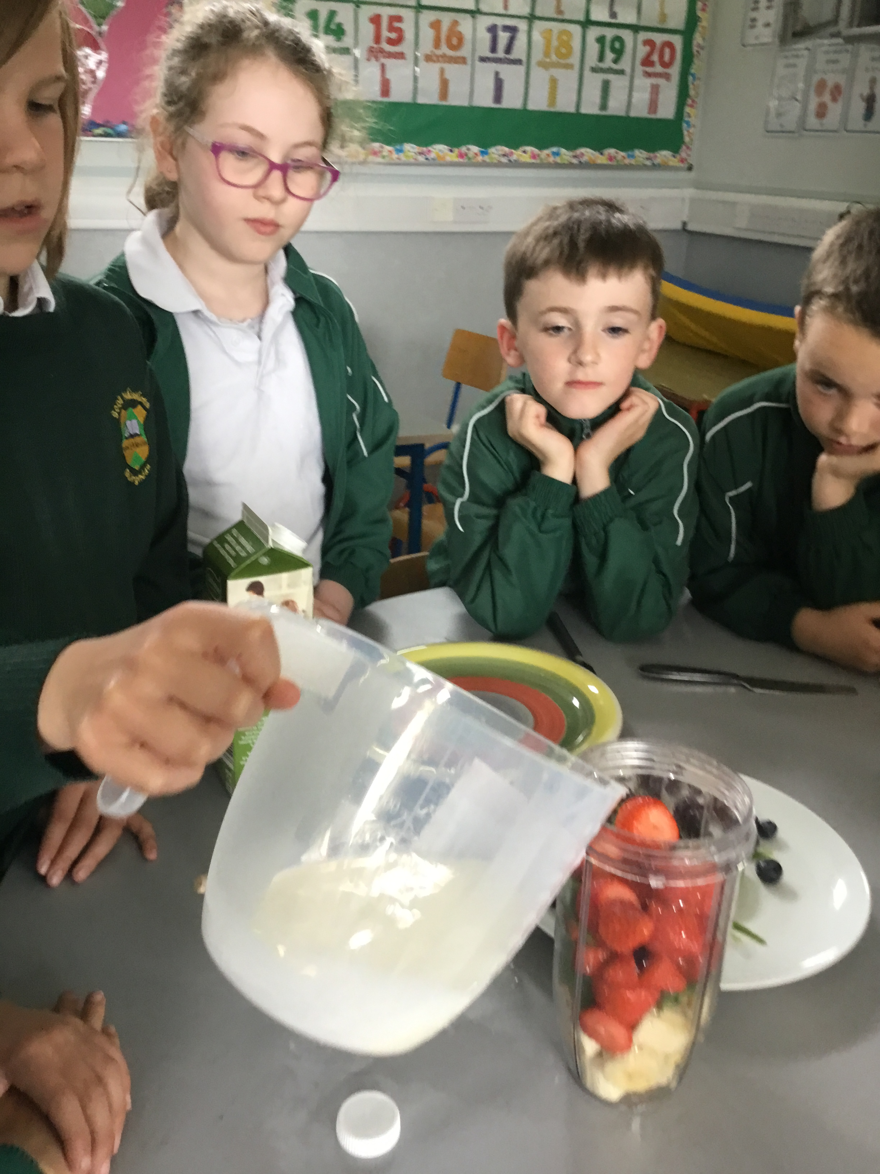
Maths and Science
We have been learning about weight and capacity so we measured and weighed to make smoothies in school.
We made sure to use Irish ingredients to which we added our own produce from the school greenhouse

Slide 17
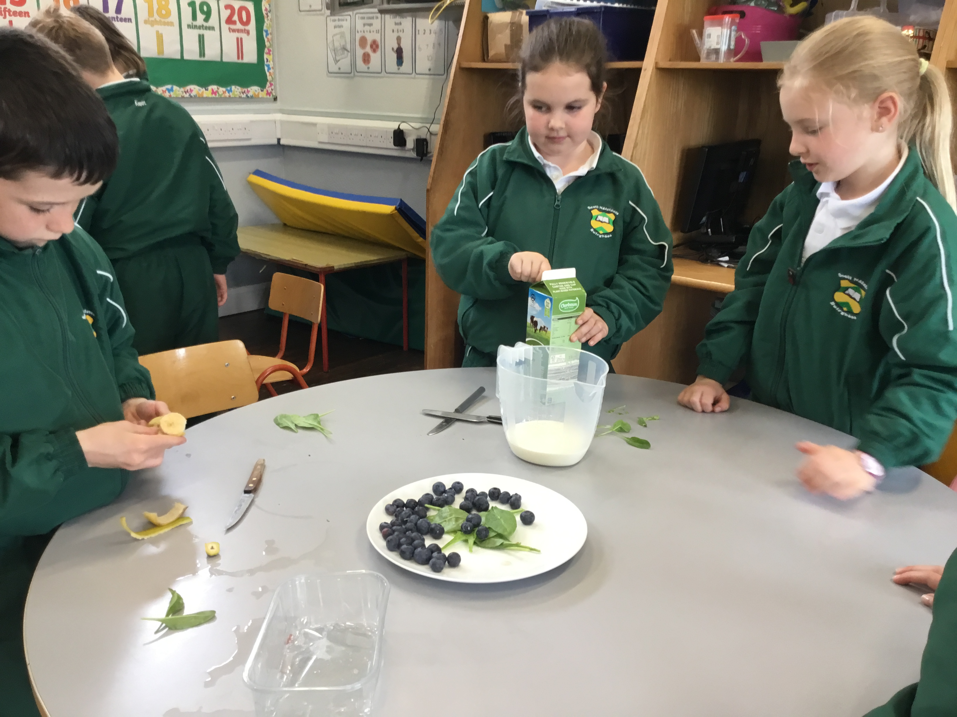
English and Science
We know how to write a procedure so we followed the steps to make some healthy snacks in school
We made sure to use fresh Irish produce in addition to our produce from the greenhouse

Slide 18
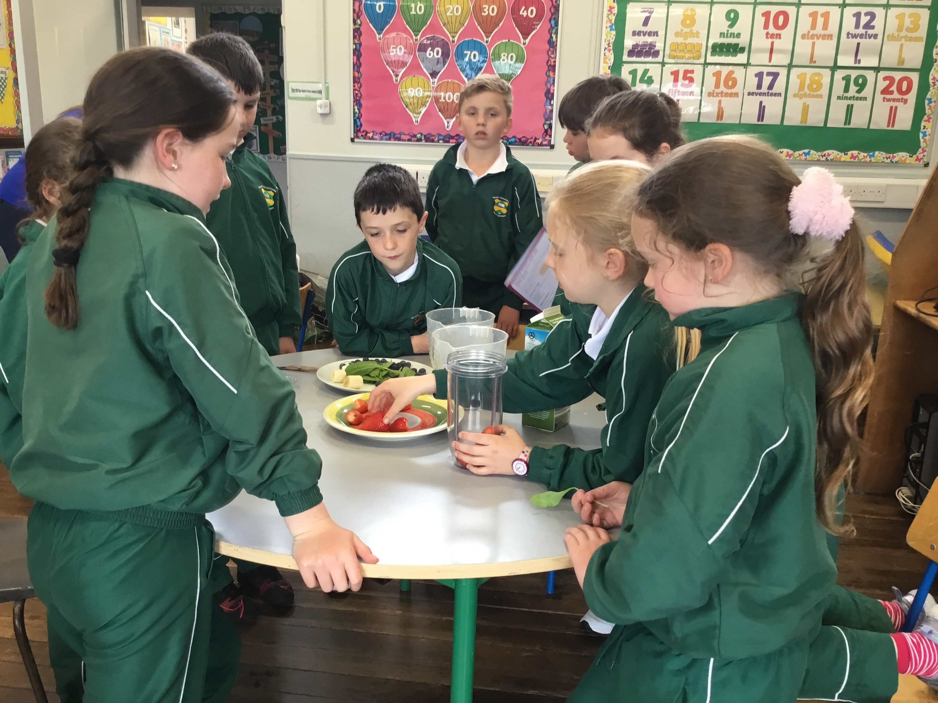
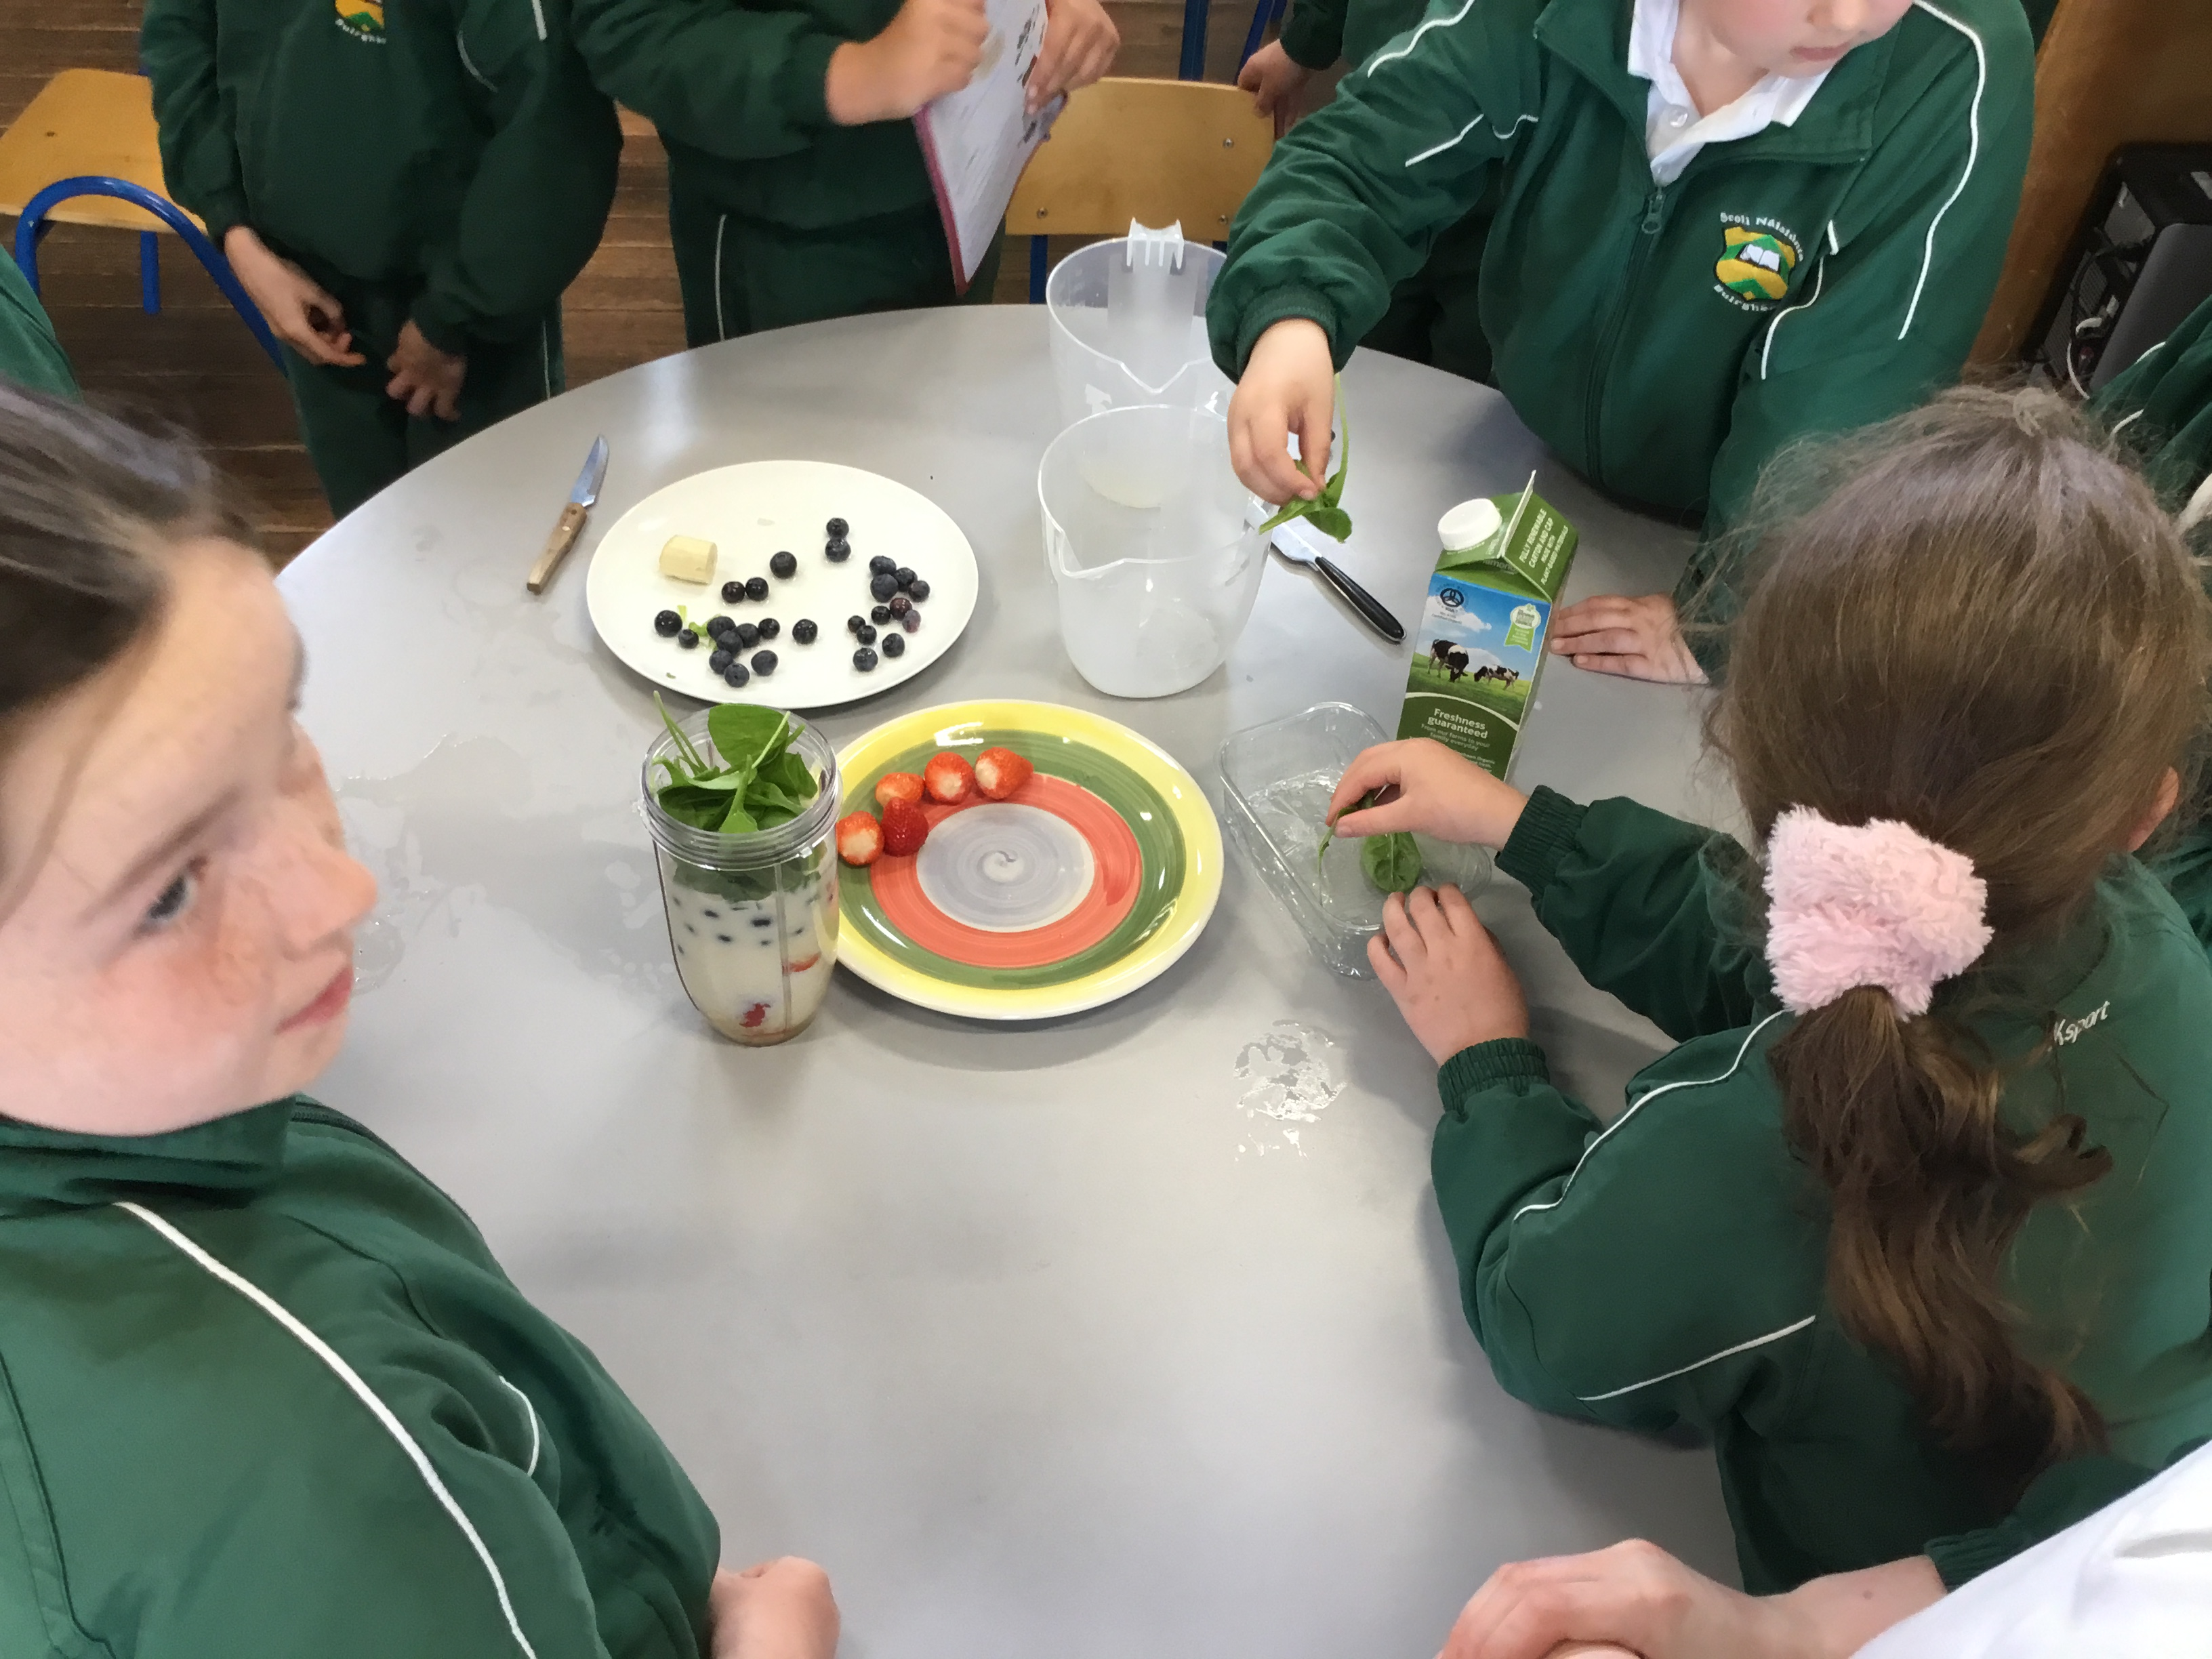
All hands helping out!

Slide 19
Taste Test………and a Thumbs Up!!

