Slide 1
Incredible Edibles Task 2
Log of Evidence
Burgess N.S.
1ST 2ND 3RD Class

Slide 2
Task 2
We learned about the Bord Bia Quality Mark
We looked in our presses to find food that was produced in Ireland
We made lists of food produced in Ireland
We learned about foods that suit our Climate

Slide 3
Our first task was to look for the Bord Bia quality mark on food at home

Slide 4
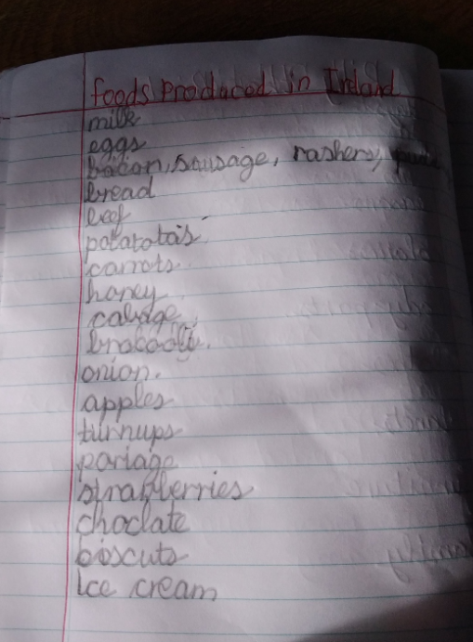
Our responses……

Slide 5
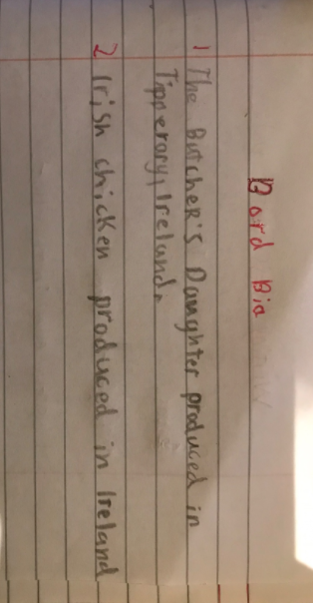
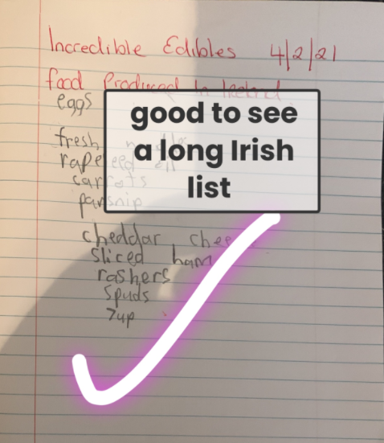
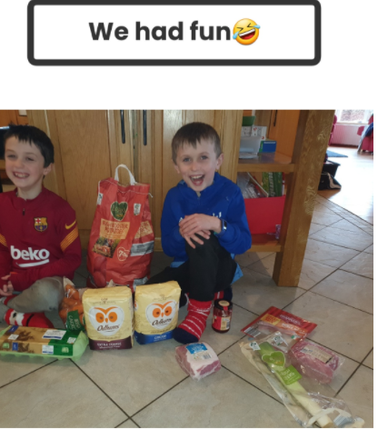
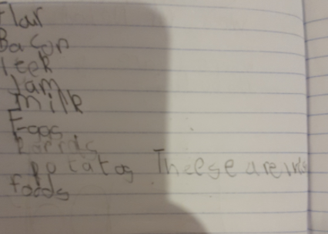

Slide 6
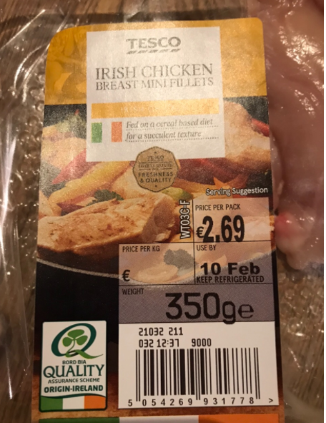
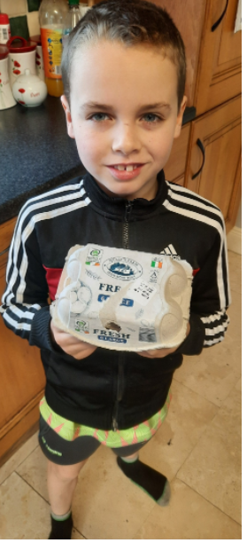
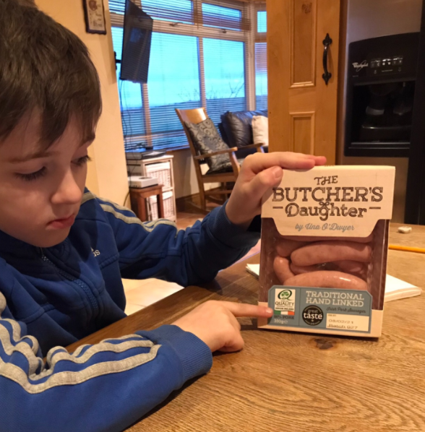
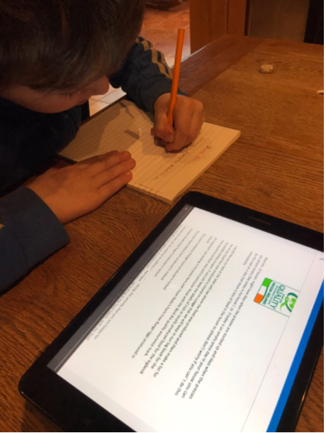
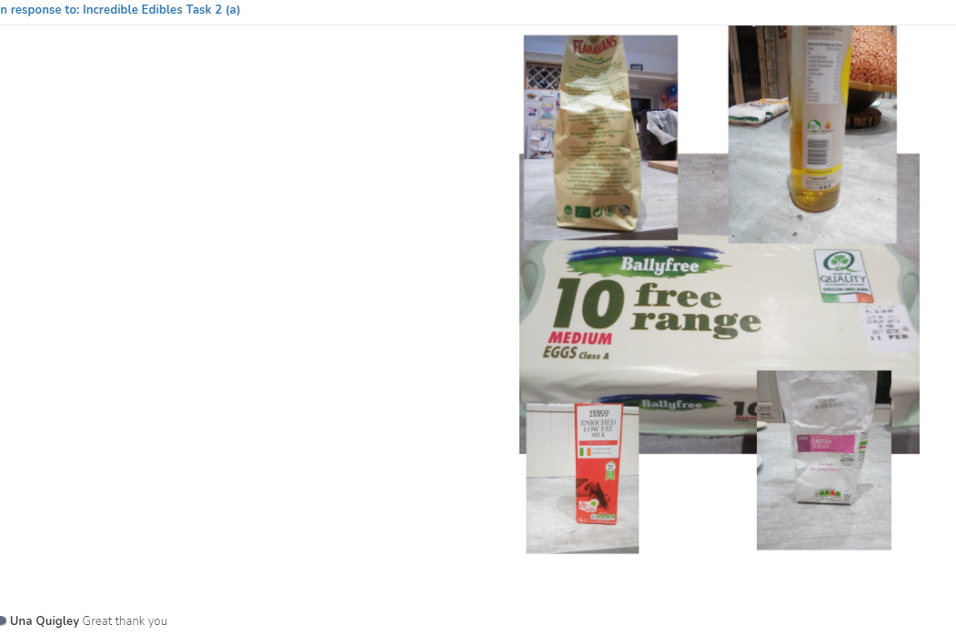

Slide 7
We sent videos on seesaw… lots of videos. Ms Quigley was so impressed by our work!

Slide 8
Another video ready for the Bord Bia marketing department!

Slide 9
We collected labels and made a poster

Slide 10
We went shopping after we had learned about Food in Season and checked out the Bord Bia Calendar

Slide 11
We were so very very excited to be named as an Incredible Edibles School

Slide 12
The End

